Slide 1


Explanation of covid-19 mortality risk for people
Dawid Przybyliński, Hubert Ruczyński, Kinga Ułasik

Slide 2
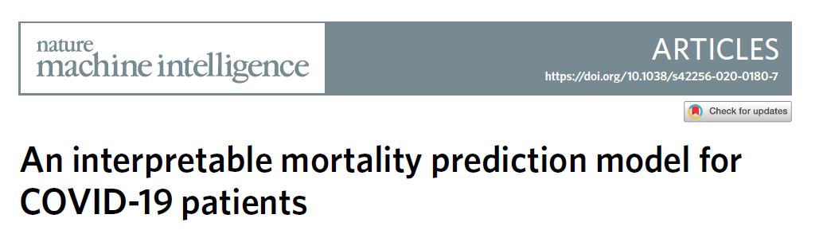
Article Analisys

Slide 3
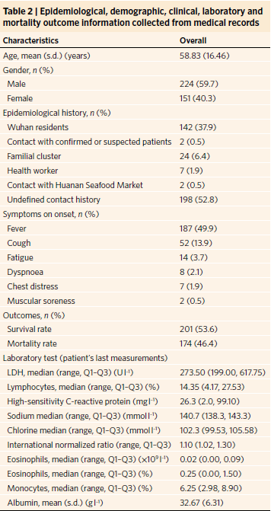
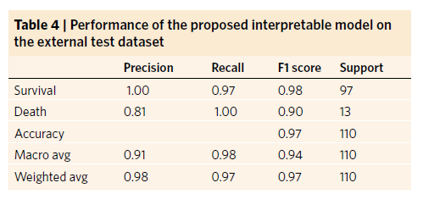
Medical records - blood samples

Slide 4
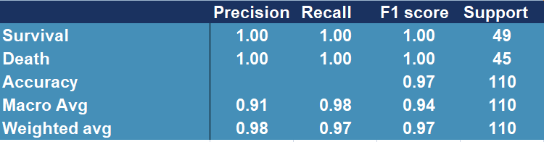
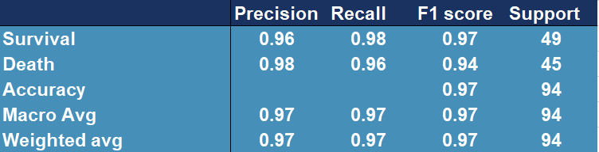
Gradient Boosting and Ada Boosting

Slide 5
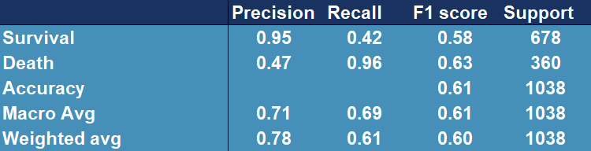
Testing model on the additional data

Slide 6
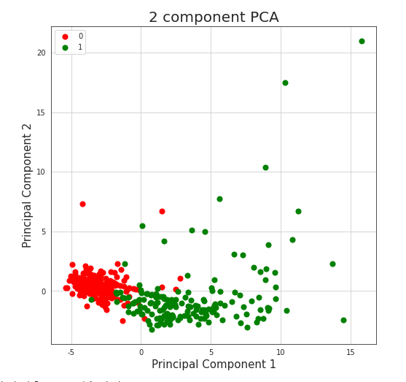
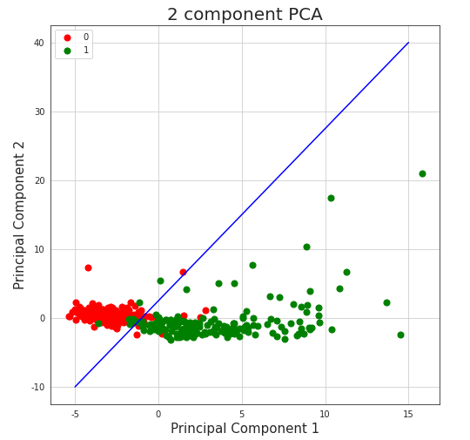
PCA

Slide 7
issues
Small number of record on the original dataset
‘Black box’ models – lack of transparency
Not high enough scores for medical purposes
Neccessary data are not easily accesible to an average person

Slide 8
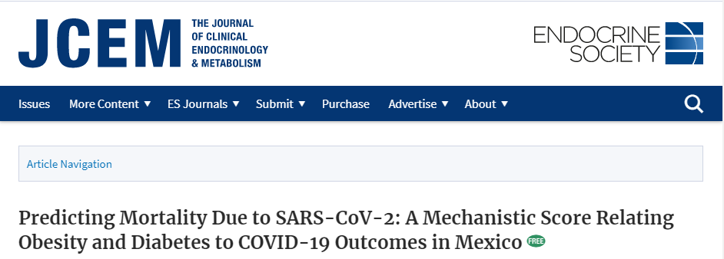
Predicting Mortality Due to SARS-CoV-2

Slide 9
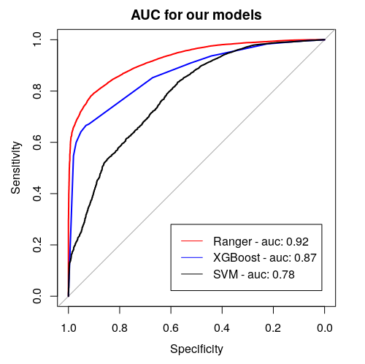
Ranger, xgboost, Support Vector Machines

Slide 10
summary
Creating an application working with data everybody has access to
Using an explainable model
Present a different approch to the problem
Achieving high AUC score

Slide 11
Thank you for your attention

